Slide 1
Q&A for HUAWEI smartphone users:
Question |  | Page.
Q1 | A smartphone cannot receive a call with PUSH is ON. | 2

Slide 2
Q1 | A smartphone cannot receive a call with PUSH is ON.
A1 | After changing the following settings, please try if Push Notification works : Change the App launch setting For details, see next page.

Slide 3
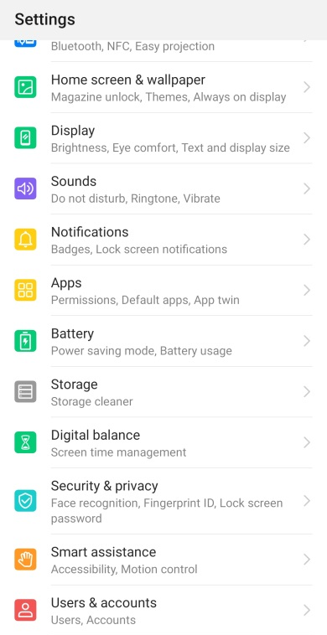
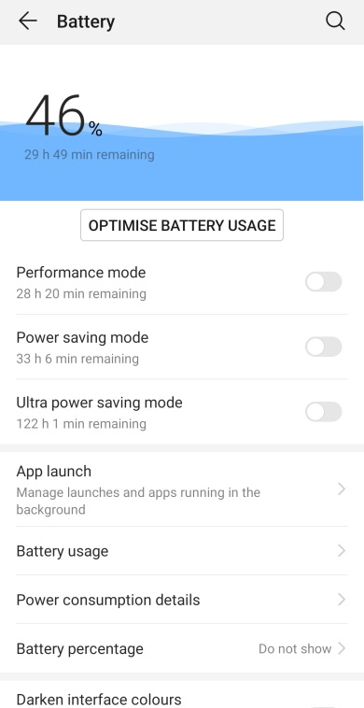
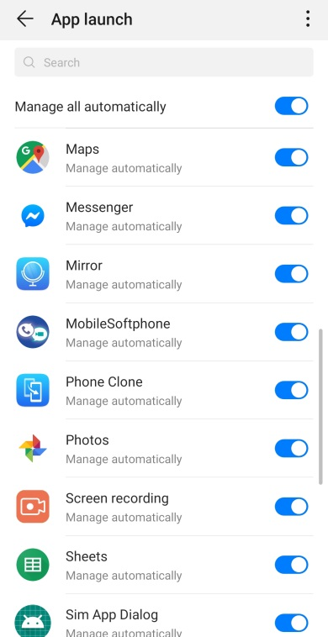
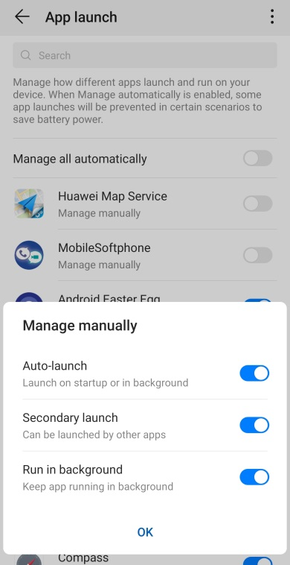
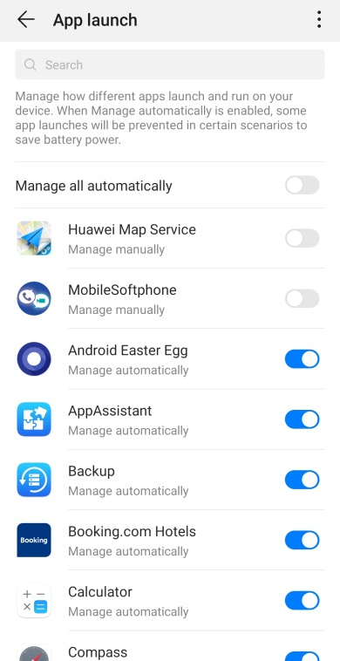
1. Change the App launch setting
On the Settings screen:
Select Apps
Select App launch
Select “MobileSoftphone”
Tap OK on Manage manually dialog
Confirm the Toggle of MobileSoftphone is OFF (Manage manually)
Mate 10 Pro (EMUI ver 9.0.0):

